Slide 1
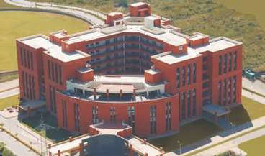



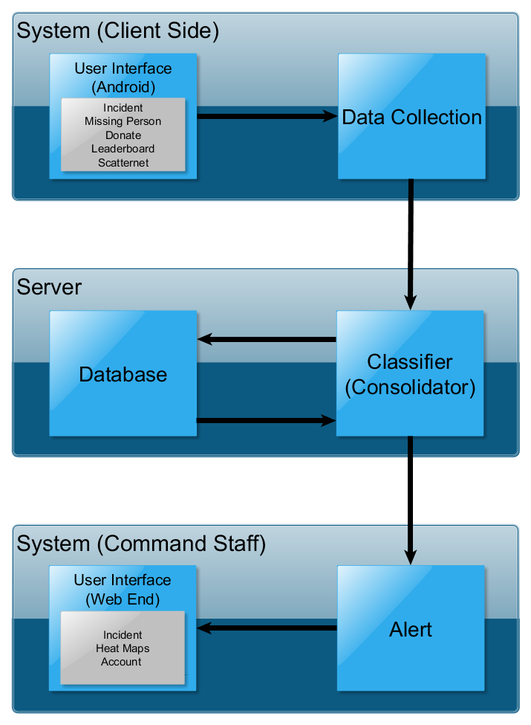

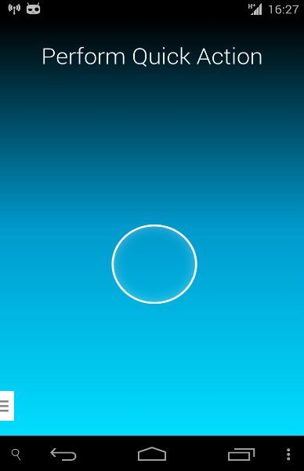





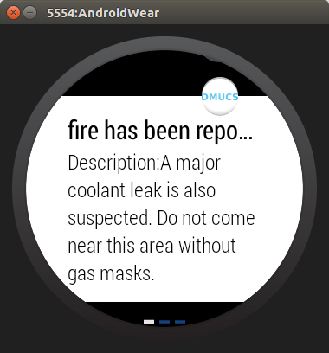
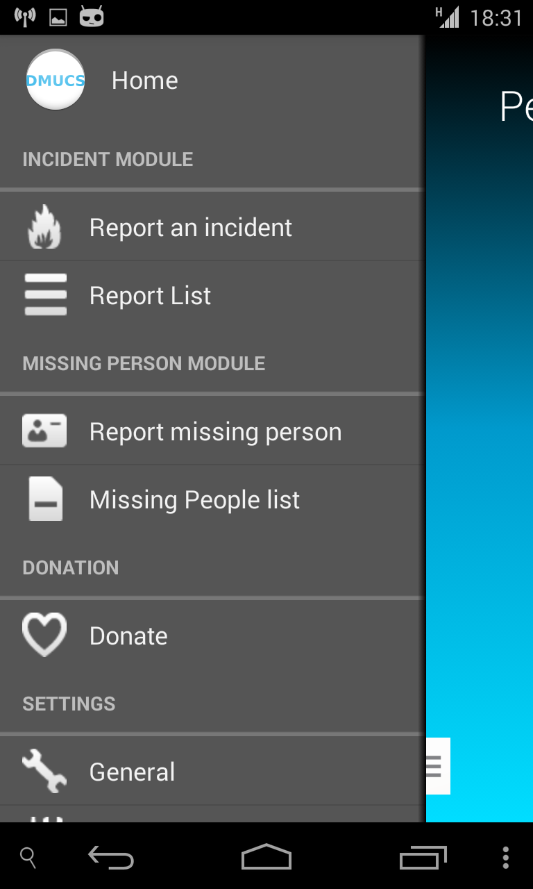

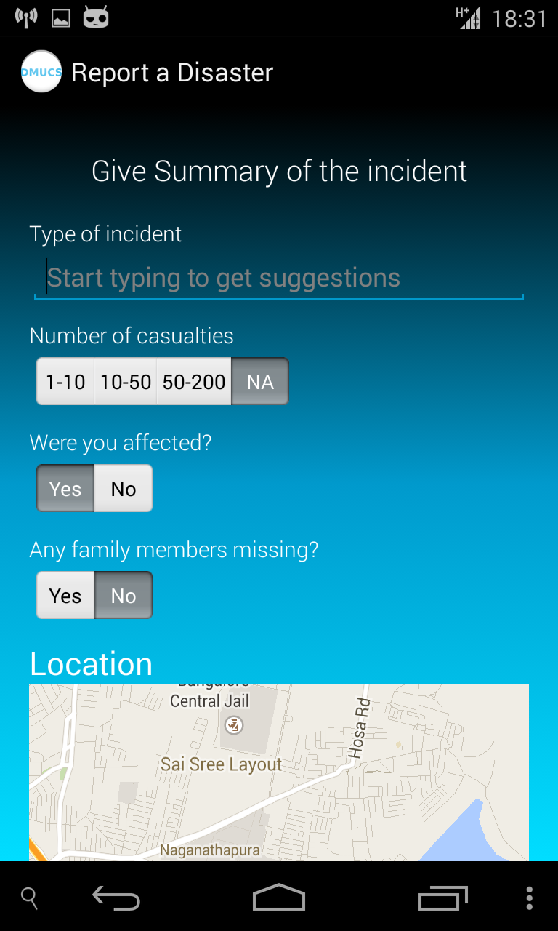
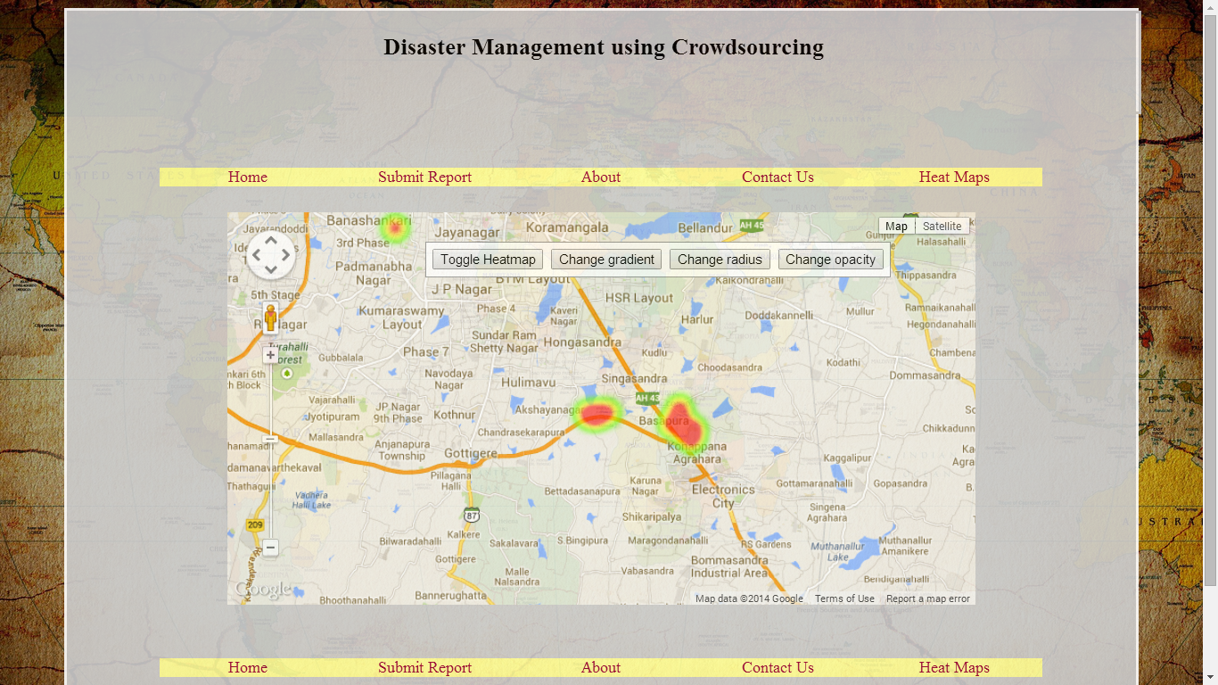

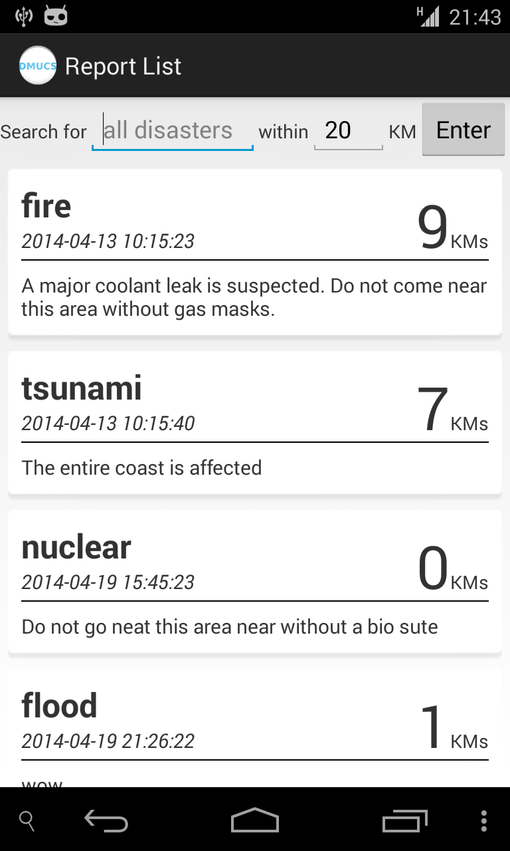
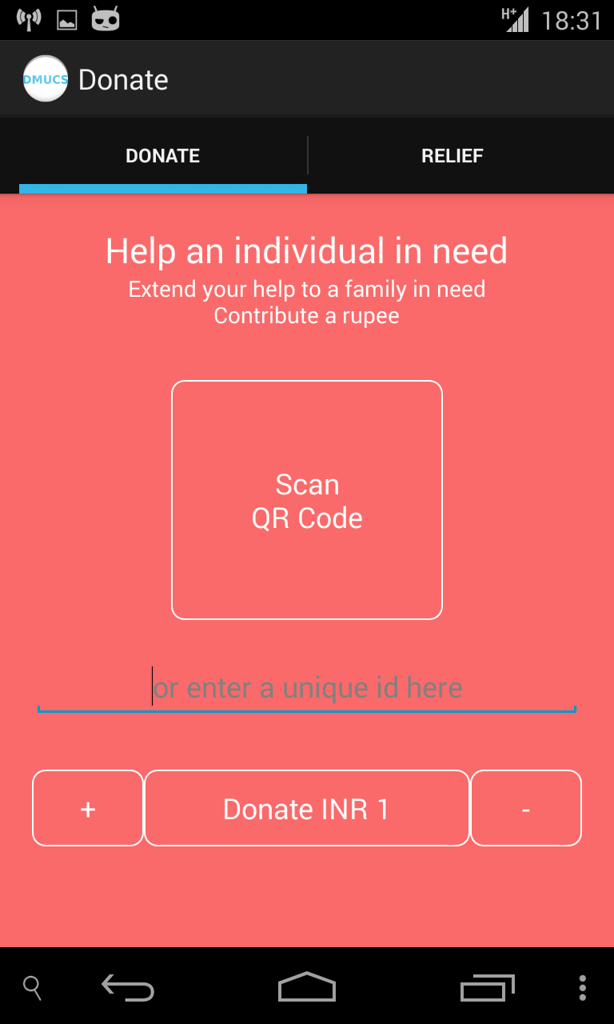
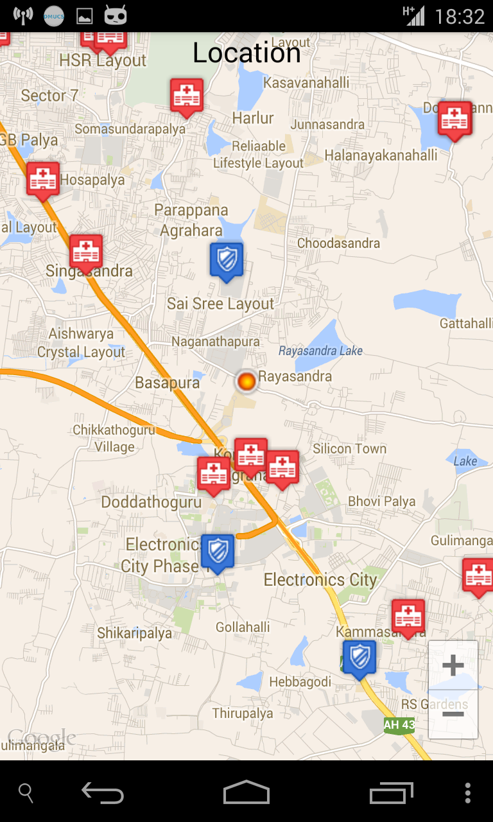
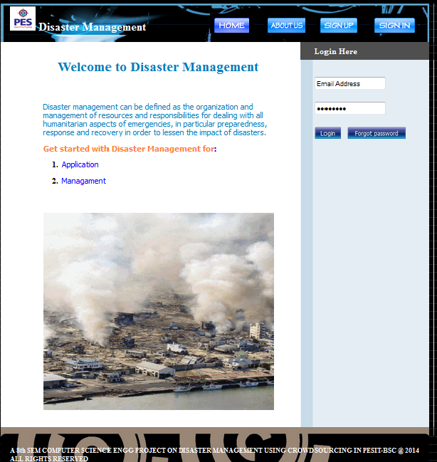
PES Institute of Technology
Department Of Computer Science and Engineering
Disaster Management Using Crowdsourcing
Report Incident
Geo Location
Incident
Incident Reports
Missing Person Reports
Donations
Votes
Scores
Cluster
Precise, accurate incident information and other alerts
Information Processing
Data storage
Report Classifier
Database
Database
Database
Architecture Diagram
Data Flow Diagram
Screenshots
Project Guide:
Mrs. Bidisha Goswami
Assistant Professor
Department of CSE
PESIT-BSC
Team Members:
Arpith K -1PE10CS018
Kumar Vishal -1PE10CS047
Vinutha M V -1PE10CS115
Manigandan C -1PE11CS408

